Slide 1
DigKeyAttitudes DT
Curiosity
Being able to want to explore multiple possibilities
Curiosity is considered a strong motivator of learning and is associated with better learning outcomes (Reio & Wiswell, 2000).
Curiosity reflects a human tendency to make sense of the world and that we are curious about things that are unexpected or that we cannot explain. The ‘gap in our knowledge’ makes us curious.
‘The best way to learn ‘how-to learn’ is to get addicted to curiosity’.
There are two basic types of curiosity: cognitive (the desire for new information) and sensory (the desire for new sensations and thrills) (Reio, 2012).
There are five main principles for evoking curiosity: novelty, partial exposure, compexity, uncertainty and conflict (fig. 1) → when this happens you get the effect as illustrated in figure 2
Encounter: having an open mind
Explore: having the drive to explore the posibilities of ‘new things’
Discover: finding out/discovering how new things work and how they can be applied in your work (as a digital tutor)
Adjust: apply newly learned things in your work (as a digital tutor)
Hey!
What’s that?
How does it work?
Aha!

Slide 2
DigKeyAttitudes DT
Curiosity
Fig. 1
(Anderson, 2013)

Slide 3
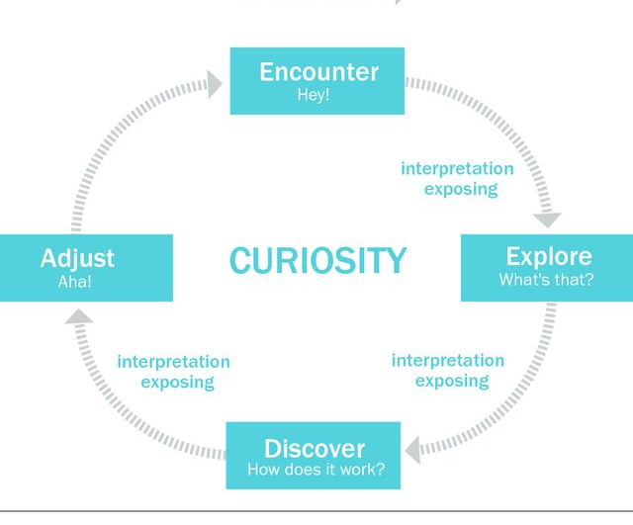
DigKeyAttitudes DT
Curiosity
Fig. 2
(Anderson, 2013)

Slide 4
DigKeyAttitudes DT
REFERENCES
Curiosity
Reio, T.G., & Wisswell, A. (2000). Field investigation of the reationshop among adult curiosity, workplace learning, and job performance. Human Resource Development Quarterly, 11, 5-30.
Reio, T.G. (2012). Curiosity and Exploration. In: Seel, N.M. Encyclopedia of the sciences of Learning. Springer, Boston, MA.
Anderson, S. (2013). Applying Curiosity to Interaction Design: Tell me Something I don’t know.

